Slide 1
Alexa*Hack
CPT John Fernandes, CPT Alex Master
Image source: https://s-media-cache-ak0.pinimg.com/originals/f9/20/e4/f920e4b1653cf96f997c818b45634d0c.jpg

Slide 2
Agenda
Demonstration
Problem Statement
Problem Analysis
Project Overview
Analysis
Conclusion/Future Development
Questions/Discussion

Slide 3
Demo!
Pull up Alexa
“Alexa, scan [an IP] (a saved variable with evilbotnet or whatever tgt we choose)
Walk through the menus (setting IP for target, setting scan type, )
Display output file (from CLI, nice to have would be Alexa parse and read pertinent information)

Slide 4
Problem
How do we hack using a speech recognition interface?

Slide 5
Framing the Problem
Verbal Interaction:
Various speech recognition programs has existed for decades
Interacting with applications verbally has risen in prominence with digital assistants such as Alexa (Amazon), Cortana (Microsoft), and Siri (Apple)
These assistants are extensible, each with their own unique API.
Hacking:
The vast majority of hacking tools use a command line interface (CLI)
Input follows well defined formats within a limited set of possible inputs/options
Although many tools can be run with a single command (such as nmap), they can also have numerous options and some run in an interactive mode (such as metasploit console)

Slide 6
Project Goals
Develop a code base that executes NMAP commands based on user verbal interaction, in order to provide a proof of concept and a framework for implementing additional hacking tools.
Project supports executing the most common options for NMAP
Interaction is colloquial and robust
Code design is modular and extensible, with increased functionality for the NMAP scan and addition of other hacking tools

Slide 7
Project Design: Overview
User
speech
Event Engine
sys cmd
Tools
Translator
intent
AlexaHack
spoken commands
Tools
Translator
events
nmap
Other tools
nmap
Other tools
nmap
Other tools
Event Engine
nmap
Other tools
Project Structure
Pre-built Elements
Elements within scope of project
Future Work
Information flow

Slide 8
Analysis: nmap
Command
nmap
execution
Nmap [<scan type>][<options>]{<target specification>}
<scan type>
-sS | sT | sA | sU | sN | sF | sX
<options>
-p <port ranges>
-F
<target specification>
www.target.com
127.0.0.1
-sW | sM
-sI | sU | sY | sZ | sO | b
-sL | sn | Pn
….
-v
-r
-sV
-O
-sC
-sA
-oN/oX/oS/oG <file>
-oA <basename>
127.0.0.0/24
127.0.1-2.0-255
-iL <inputfilename>

Slide 9
Analysis: Alexa
ALEXA
“Alexa, …”
5
External Service
Words
1
ECHO
Events
Top level Utterances
SKILL 1
Difficult to make hardware agnostic
Processing occurs in the cloud
Stateless execution
External service handles event
Extremely Limited dialog ability
Utterances
Event([parameters])
Words
3/4
Utterances
SKILL n
Event([parameters])
2
1. Device records the spoken words and sends to the Alexa service
2. Alexa service maps spoken words to an utterances from registered skills.
3./4.The skill maps utterances to intents and then a formatted event (with parameters)
5. The skill sends and event to an external service to execute

Slide 10
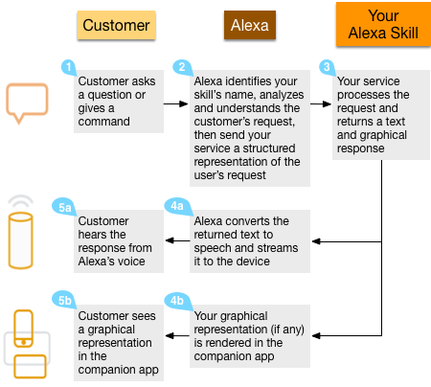
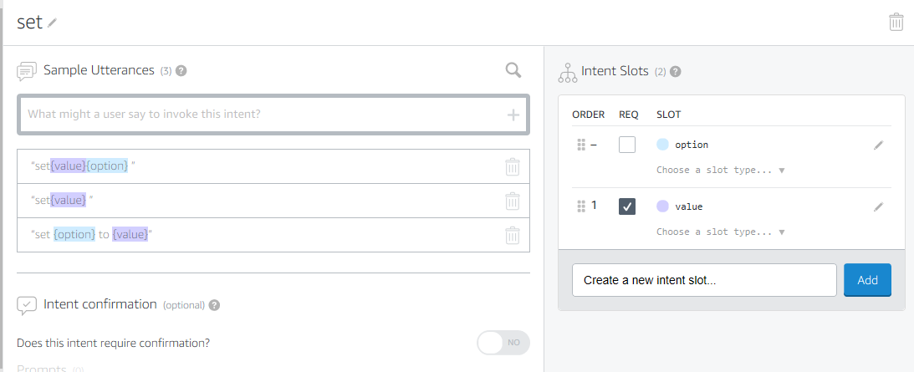
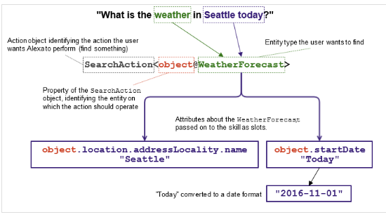
Alexa Examples

Slide 11
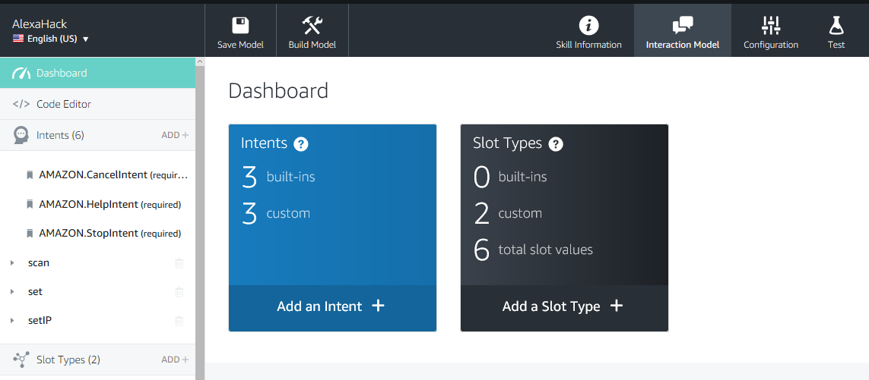
Alexa Screenshot

Slide 12
Fork in the road
We don’t want our scanning instances happening in the AWS cloud, for nefarious or otherwise users to use non-attributable (to them) infrastructure on our development accounts for their own ends.
Research other options…

Slide 13

Analysis: Cortana
“Hey Cortana, …”
Words
Windows based (Windows 10 or Mobile)
Execution can occur locally
State/stateful execution based on application
More capability for dialog mode
Requires UWP application, UWP applications are sandboxed
Windows
Cortana commands
UWP App
Background mode
App1 Specific
Interaction
App2 Specific
Interaction
Foreground mode
Processes commands (spoken or typed)
Calls against stored utterance list
Sends an event to the application

Slide 14
CORTANA DEMO

Slide 15

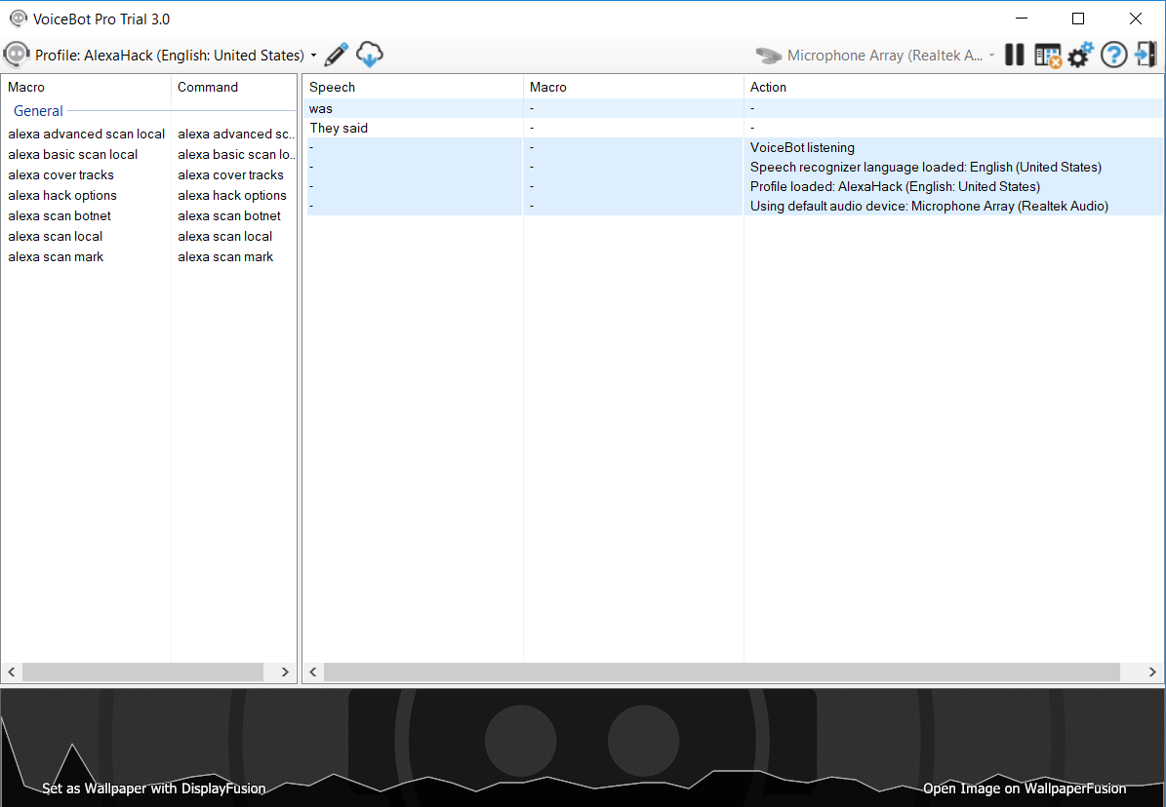
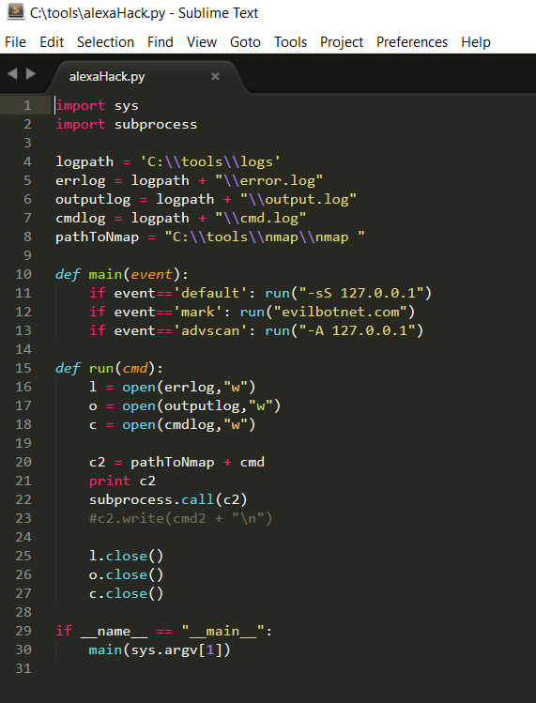
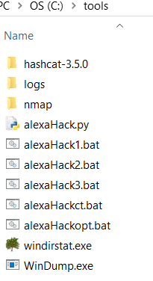
Analysis: VoiceBot

Slide 16
NMAP through dialog interface
Text interface that can be integrated into “text to speech” and “speech to text” algorithms
Portable, lightweight, and platform agnostic*
No probabilistic recognition based on expected values
User Input
Interface+
Recognition
Validated Input
Dialog handler
CMDs
nmap
Prompts/Feedback
PromptsFeedback
Menu
Interface+Recognition Module: Turns input into valid options
“thesaurus:” maps analogous input to standard commands
validate methods: evaluates to see if input met condition for command
Dialog Handler: Provides list of options, runs options
Menus: lists of commands with associated actions
Actions: dialog or command execution behavior for an option

Slide 17
.PY DEMO

Slide 18
Conclusion
Voice recognition software is not a mature technology
The current implementation of digital assistants is not well suited for integration with hacking tools.
Not portable: APIs are proprietary in nature and system dependent
API’s are tailored toward simple single commands
Development is focused on consumer convenience applications and their developers
Majority of x86/ARM software not written with voice input in mind

Slide 19
Future Work
Extensions of current project:
Implement audio component to dialog program (Bing API, Google Speech API, etc.)
Implement necessary permissions and modules to enable windows app to run CLI tools.
Implement necessary security to make Alexa viable
Branch Possibilities:
Other hacking tasks
Other speech programs (Siri, etc)

Slide 20

Questions?

Slide 21
Project Design: Flow Diagram
Module (nMap) Menu
child (option) menu
child (option) menu
C1
C2
C2
C1
Alexa
Not Ready
Menu
Ready
Menu
Check Execute
Execute
B
D
F
E
A
A | “[type] scan {IP}” “pingsweep {IP}”
B | “scan” “nmap”
D
E | A, “execute | run”
F | “Yes”
C | “What are my options?” “set {option} to {value}”
C1 | “Set {option}”
C2 | “to {value}” “cancel | exit | never mind”

Slide 22
Project Design: Flow Diagram
Specific option menu
Specific option menu
Alexa
AlexaHack Menu
nMap Menu
Execute
Check Execute

